Slide 1
CS 6475 Course Portfolio
Trevor Davidson
Spring 2024

Slide 2
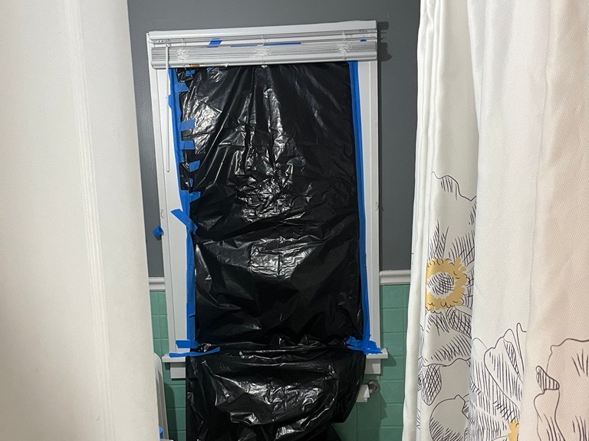
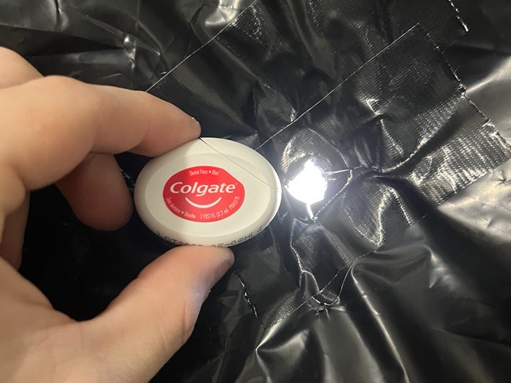
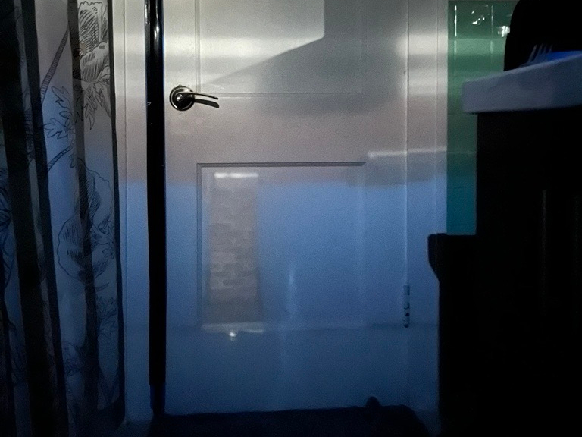
Assignment 1: Camera Obscura
Purpose: Explore camera fundamentals through construction of a camera obscura
I was able to get a good obscura! In hindsight, I would have liked to use a more-adjustable pinhole to attempt more pinhole sizes, but this was a fun and interesting experience.
Pinhole Cutout
Camera Obscura Result
Bathroom Window Covering

Slide 3
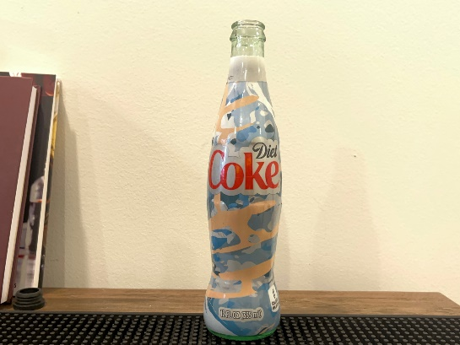

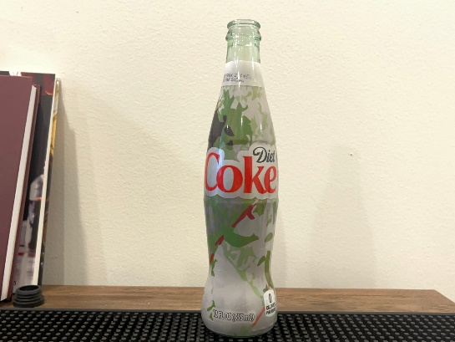
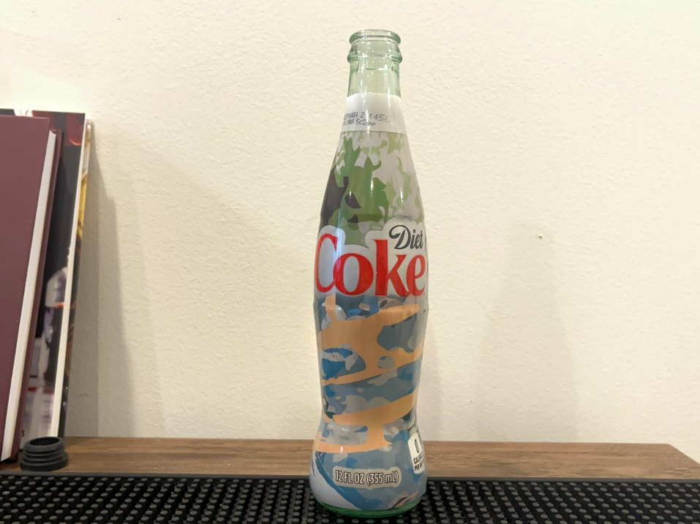
Assignment 2: Pyramid Blending
Purpose: Implement a pyramid blending pipeline to seamlessly combine images
Methodology based on 1983 Burt and Adelson paper A Multiresolution Spline with Application to Image Mosaics
Using a gaussian pyramid, Laplacian pyramid, and user-defined mask
Mask created in GIPHY
Images used for blending are two old Coke bottles with specialty skins, with goal to create a seamless blend of the images.
This was an excellent project for me, and it was awesome to see these methods used in a clever way
Input 1
Mask
Input 2
Final Result

Slide 4
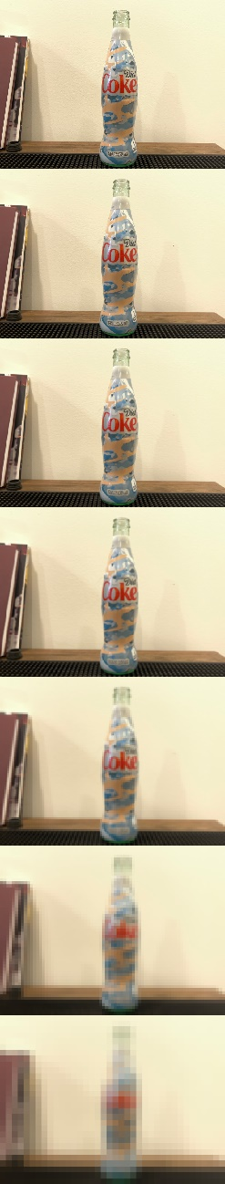
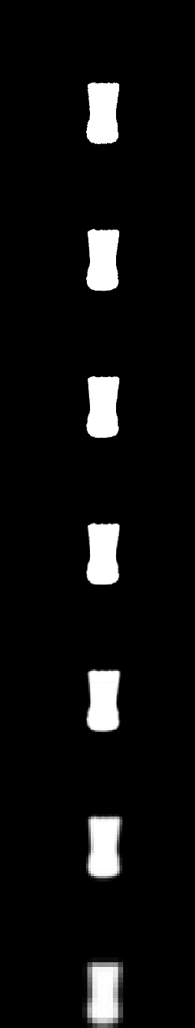
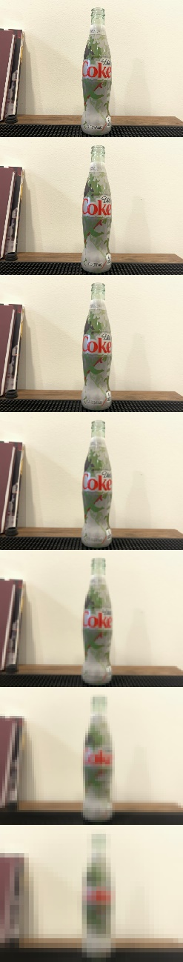
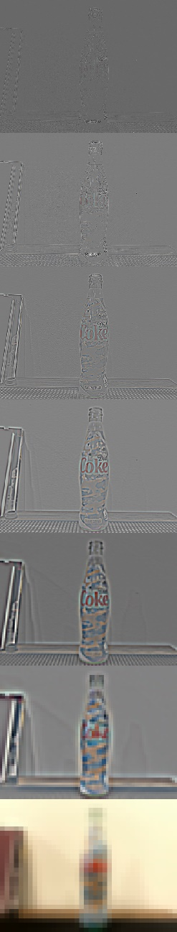
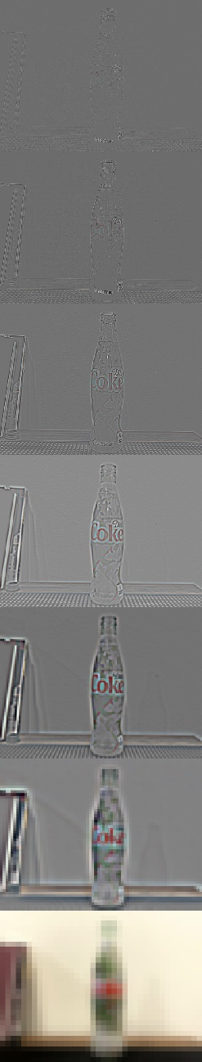
Assignment 2: Pyramid Blending
Gaussian Pyramids
Laplacian Pyramids

Slide 5
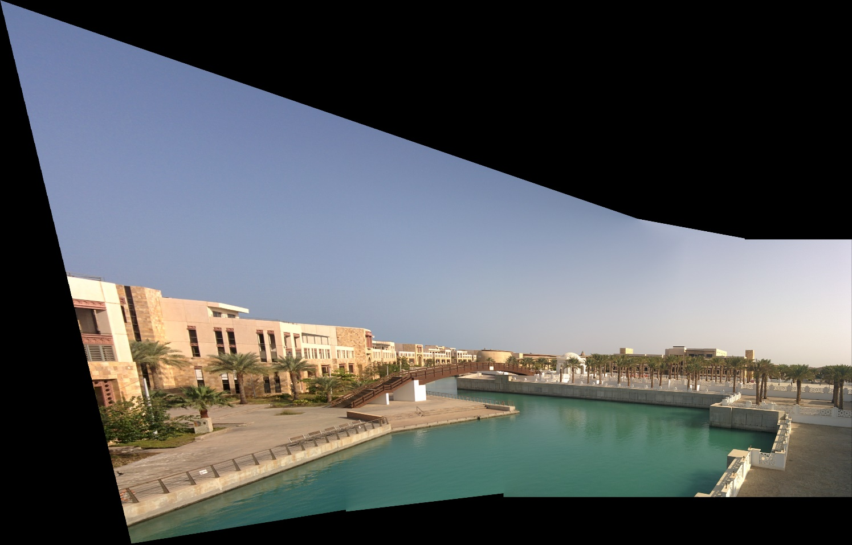
Assignment 3: Panoramas
Purpose: Align and blend multiple adjacent images to create a panorama
Process pipeline
Identify image keypoints
Use keypoints to find a homography between each pair of images
Use homography to warp the first image into the plane of the second image
Create a blending mask to combine images at boundary
Use alpha mask and warped images to combine images
Use new combined image and continue to extend with additional images
Generally, I got good results from this project and had fun experimenting with different image sets
Panorama built with my Assignment 3 code

Slide 6
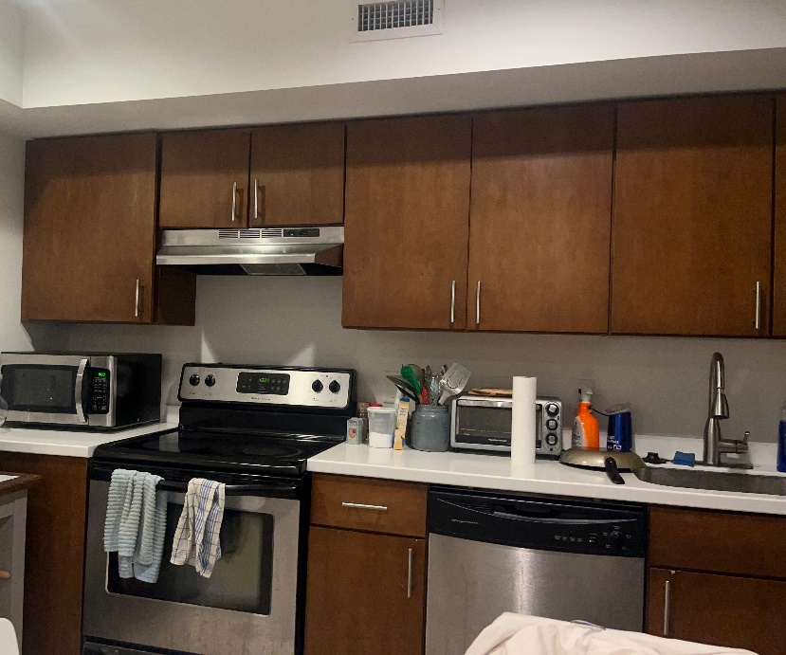
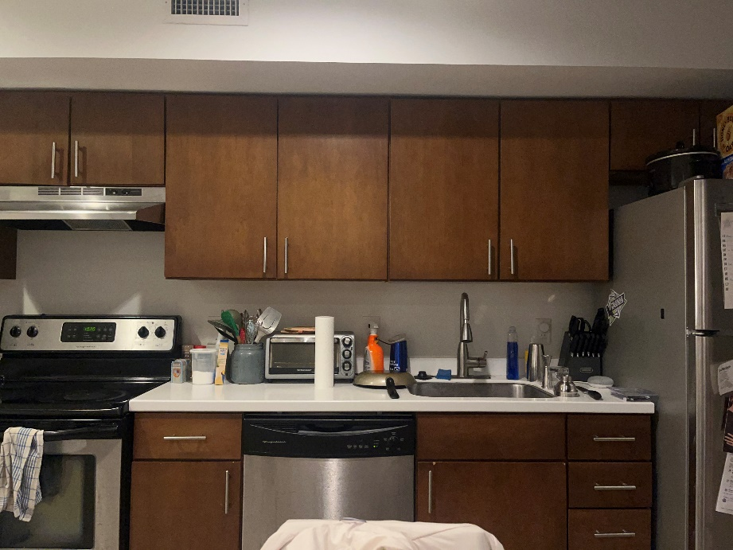
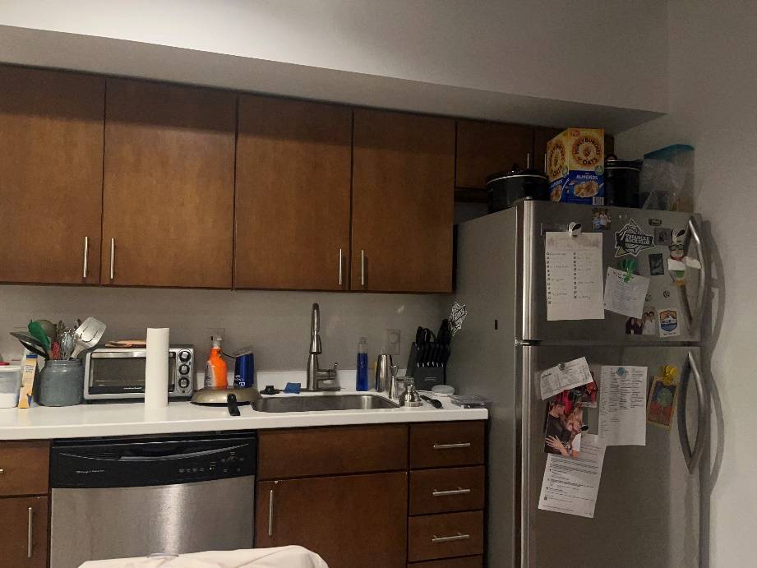
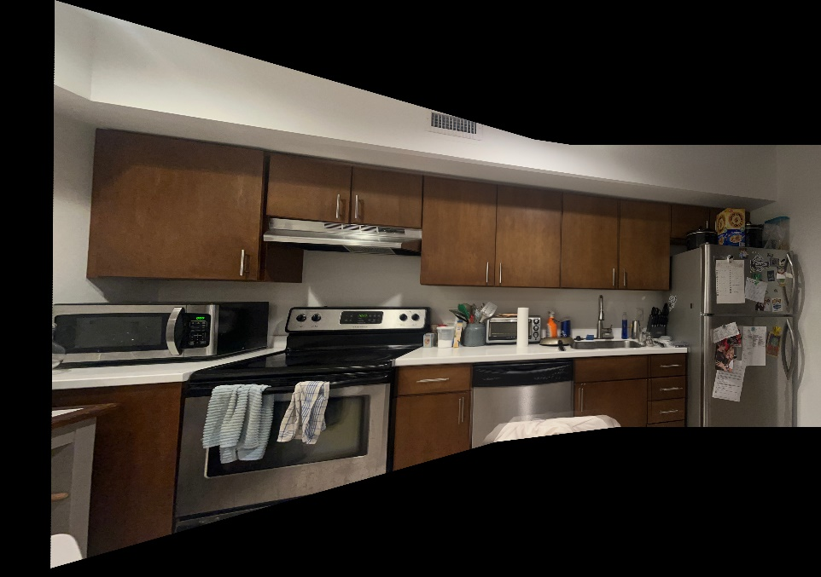
Assignment 3: Panoramas
Left Image
Middle Image
Right Image
This is my kitchen, panoramized into one image!
Final Result

Slide 7
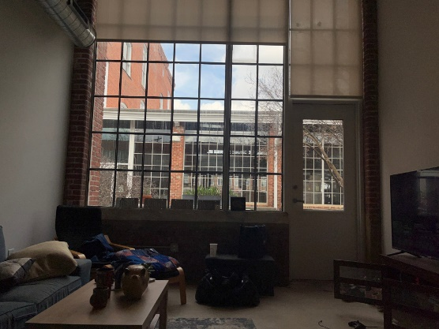
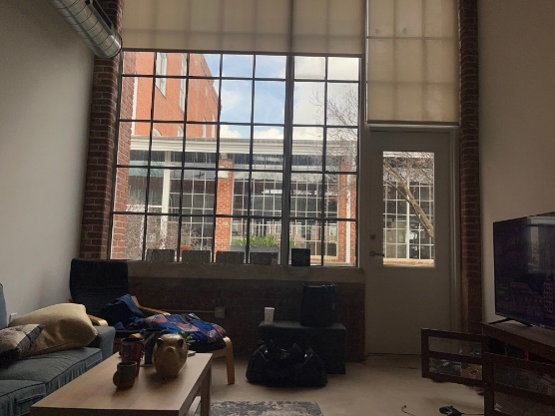
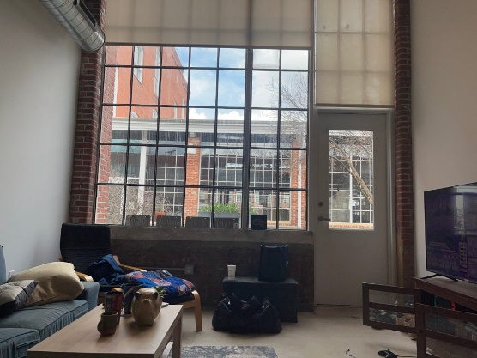
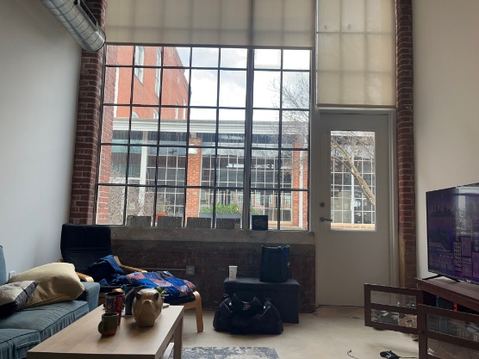
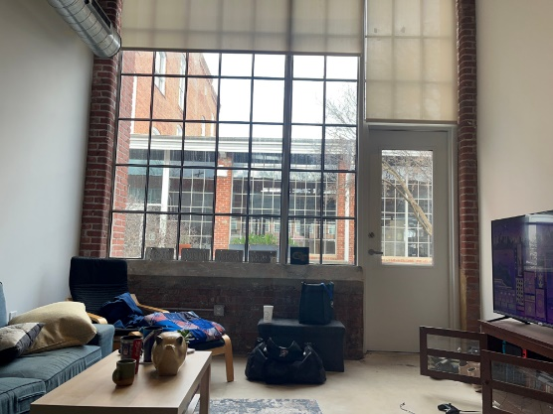
Assignment 4: HDR
Purpose: Create high-dynamic range images with a variety of algorithms
Uses core methodology outlined in “Recovering High Dynamic Range Radiance Maps from Photographs” by Debevec & Malik.
I also implemented Histogram Equalization algorithms described by Bob Cromwell and Wang & Ward
Using images in the HSV space, I also implemented a color enhancement methodology to produce a more life-like image
Based on peer feedback, I should expand my image set to include darker and lighter images on each end. However, the HDR still comes together well and captures a lot of the scene well
Input Images from my living room in Durham, NC

Slide 8
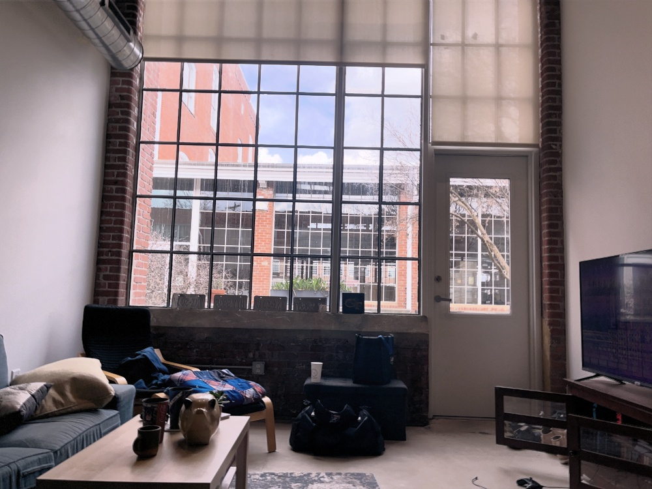
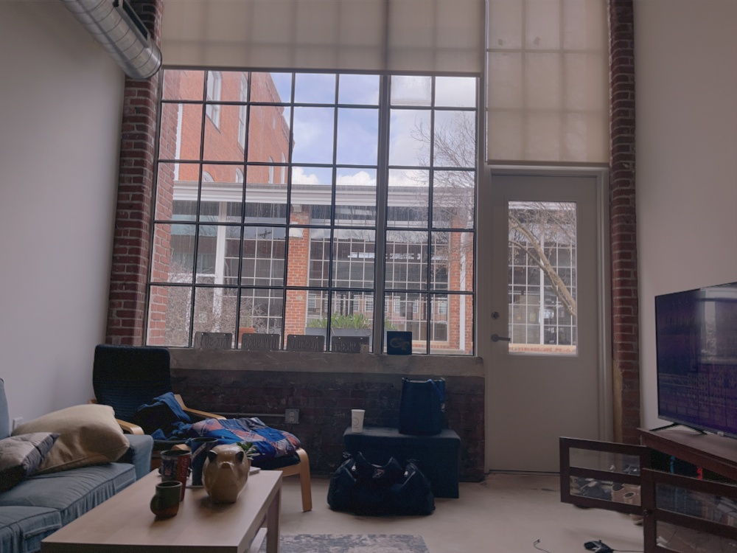
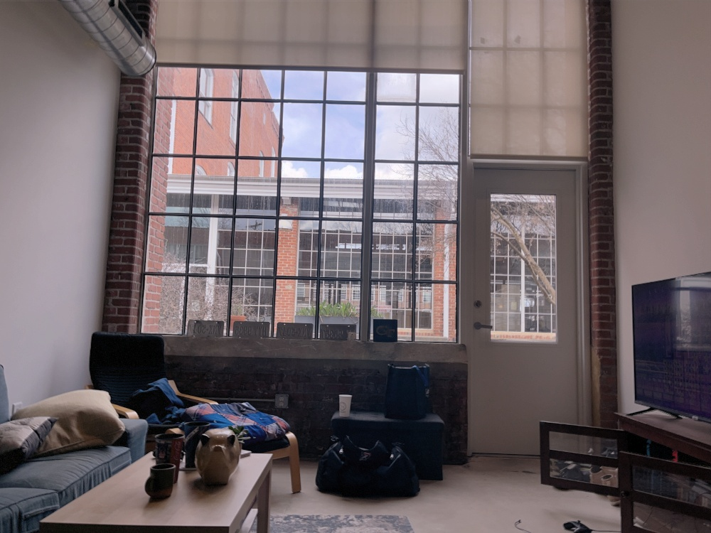
Assignment 4: HDR
HDR with Histogram Equalization
Basic HDR
HDR with Weighted and Thresholded Histogram Equalization

Slide 9
Assignment 4: HDR
HDR with Weighted and Thresholded Histogram Equalization plus Saturation Enhancement
Basic HDR

Slide 10
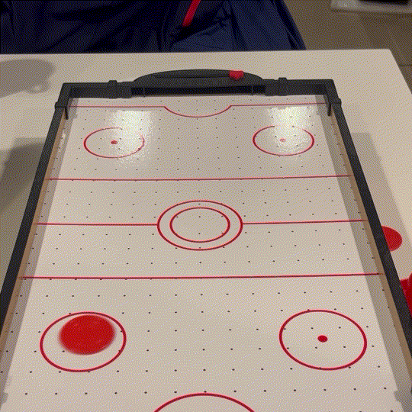
Assignment 5: Video Textures
Purpose: Create a video texture (an infinitely looping video with smooth transitions)
Uses core algorithm outlined in “Video Textures” by Schodl, Szeliski, Salesin, and Essa
Full results can be seen here: https://gatech.box.com/s/2venaiakyw7ks8kh0cvnlpob599x0pi1
I created my own video sequence using a small air hockey table
This was one of my best outputs, although I do think my results show the importance of consistent dynamics in a video texture

Slide 11
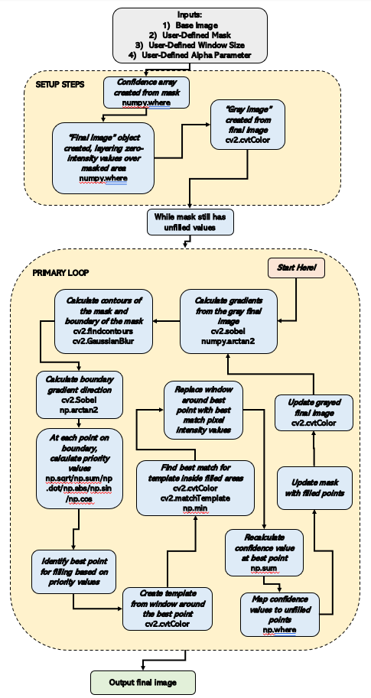
Project 1: Object Removal
Purpose: Replicate the results of the object removal algorithm proposed by Criminisi, Perez, and Toyama (2004)
Generally uses a combination of following notable features (boundaries/gradients) and filling in areas with many known pixels (high confidence) to slowly fill in area where object is to be removed with other background details
I used a few different image sets which had many small details: this made clean results difficult to achieve without great parameter tuning
This was a fairly difficult project for me. My image set made things harder, but my algorithm can use more tuning/adjustment to get completely right.

Slide 12
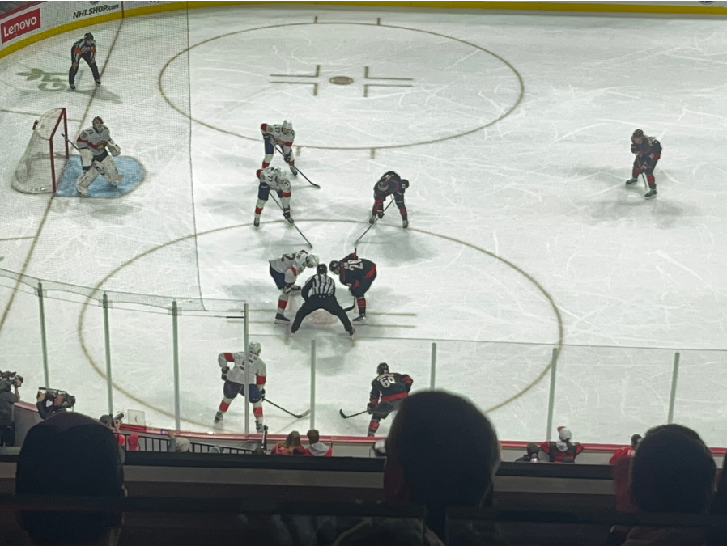


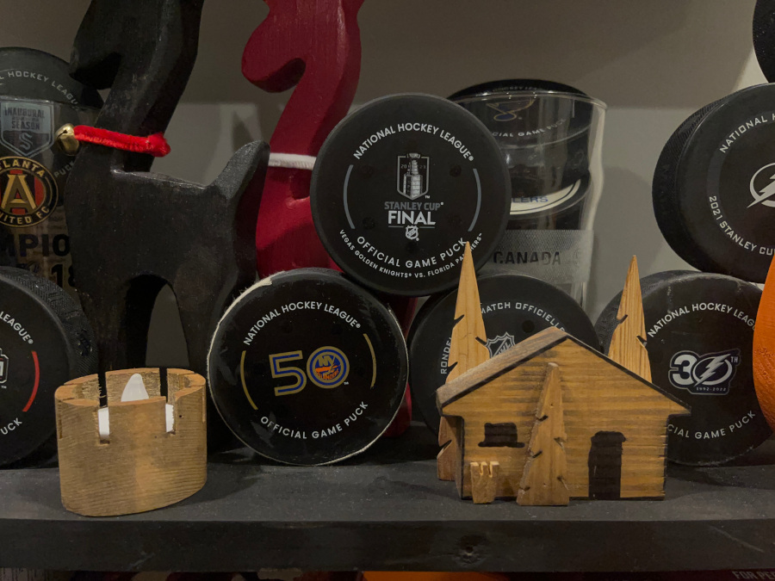

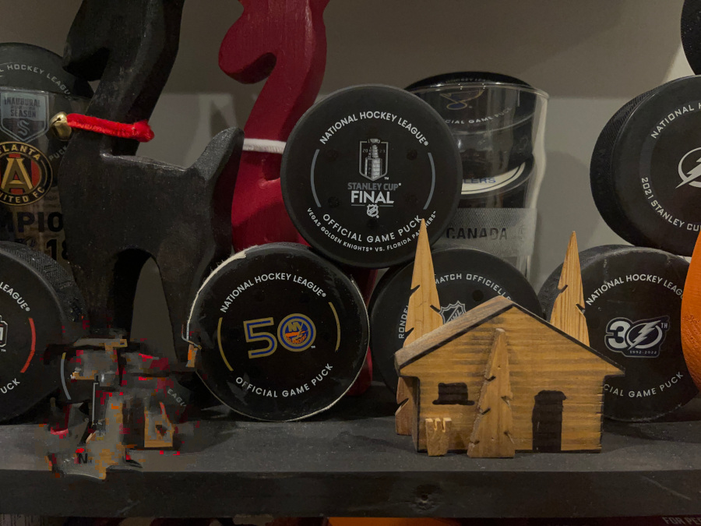
Project 1: Object Removal
Hockey Faceoff at PNC Arena in Raleigh, NC
Mask to remove one player
Final Image
Household item shelf
Mask to remove small candle
Final Image

Slide 13
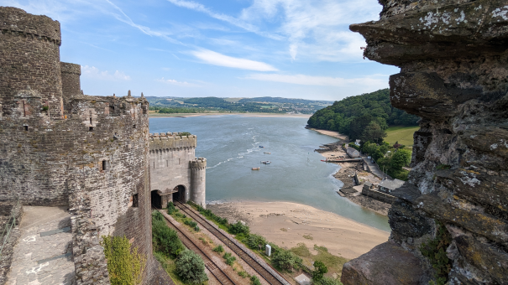
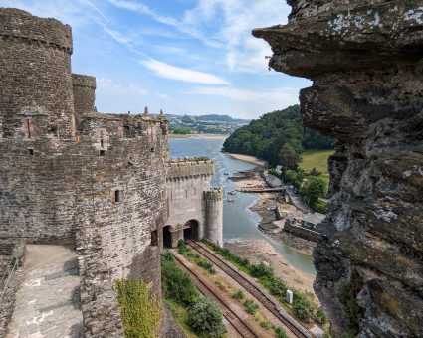
Project 2: Seam Carving
Original Image
Purpose: Replicate the results of two papers related to Seam Carving
The first paper was “Seam Carving for Content-Aware Image Resizing”, a 2007 work from Avidan and Shamir, which established the “backward energy” algorithm
The second paper was the following “Improved Seam Carving for Video Retargeting”, a 2008 piece from Rubenstein, Avidan, and Shamir. This improved on the 2007 paper with the “forward energy” algorithm, which accounted for new pixel edges created during seam carving
I also implemented a variation of the bidirectional similarity (BDS) algorithm shown by Simakov et. Al for comparing the two original paper’s images with my own
This was one of the longest, but also one of my favorite projects of the semester!
Image with 180 seams removed

Slide 14
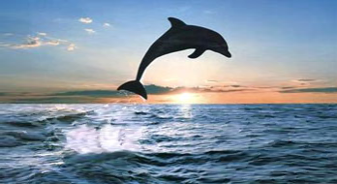
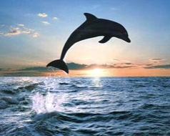
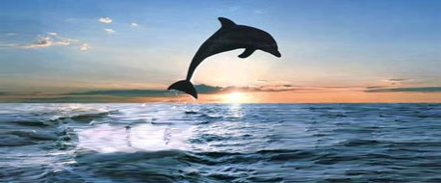
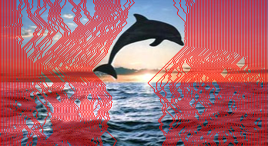
Project 2: Seam Carving
Expanded Image, 110 seams added
Original Image
Double Expanded Image, 220 seams added
Locations of added pixels

